Slide 1
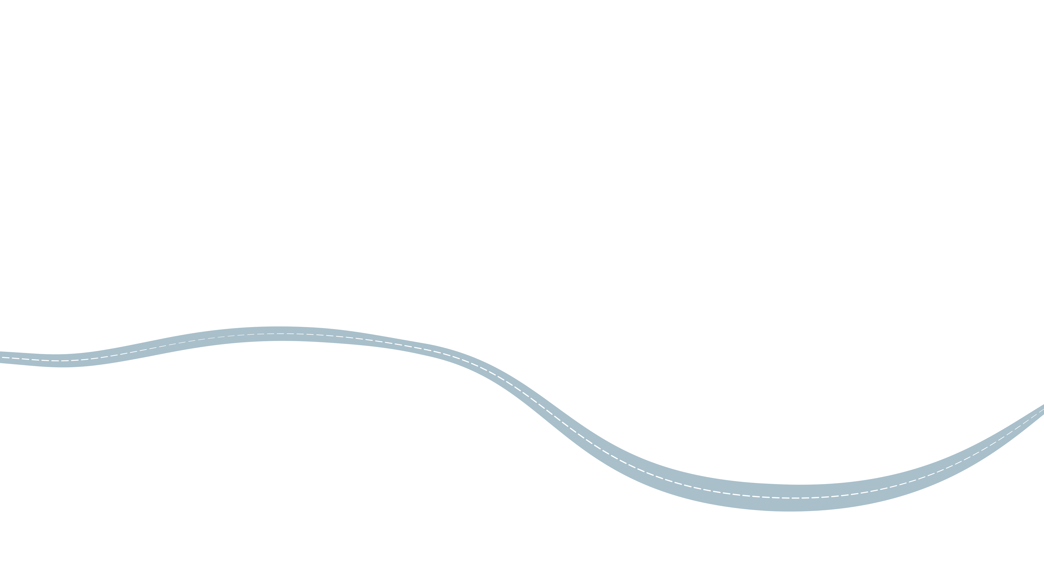



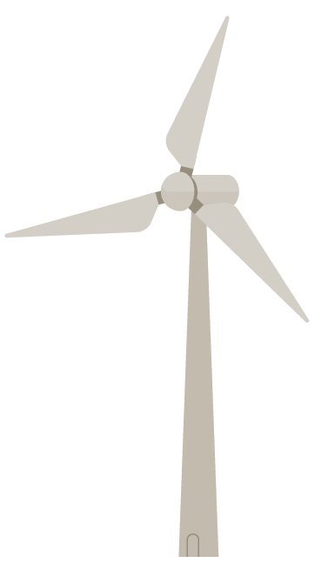
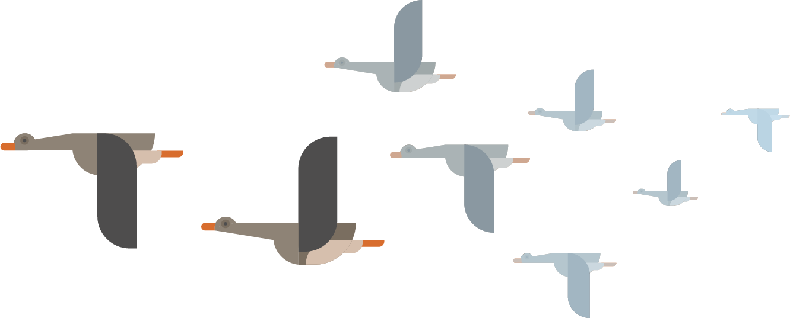
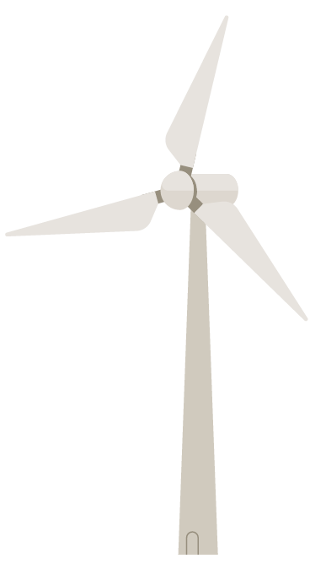


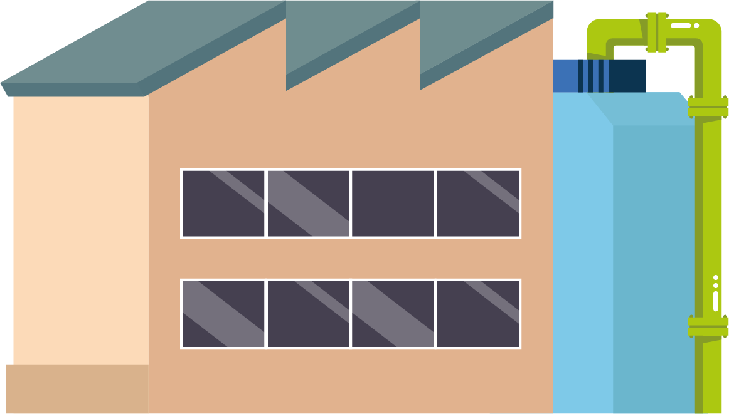





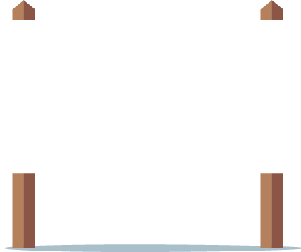
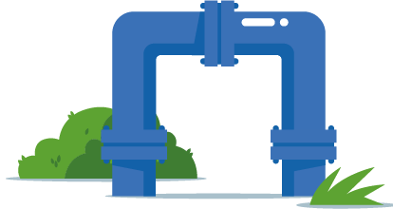


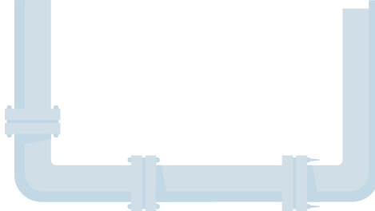
PWN drinking water distribution

Slide 2
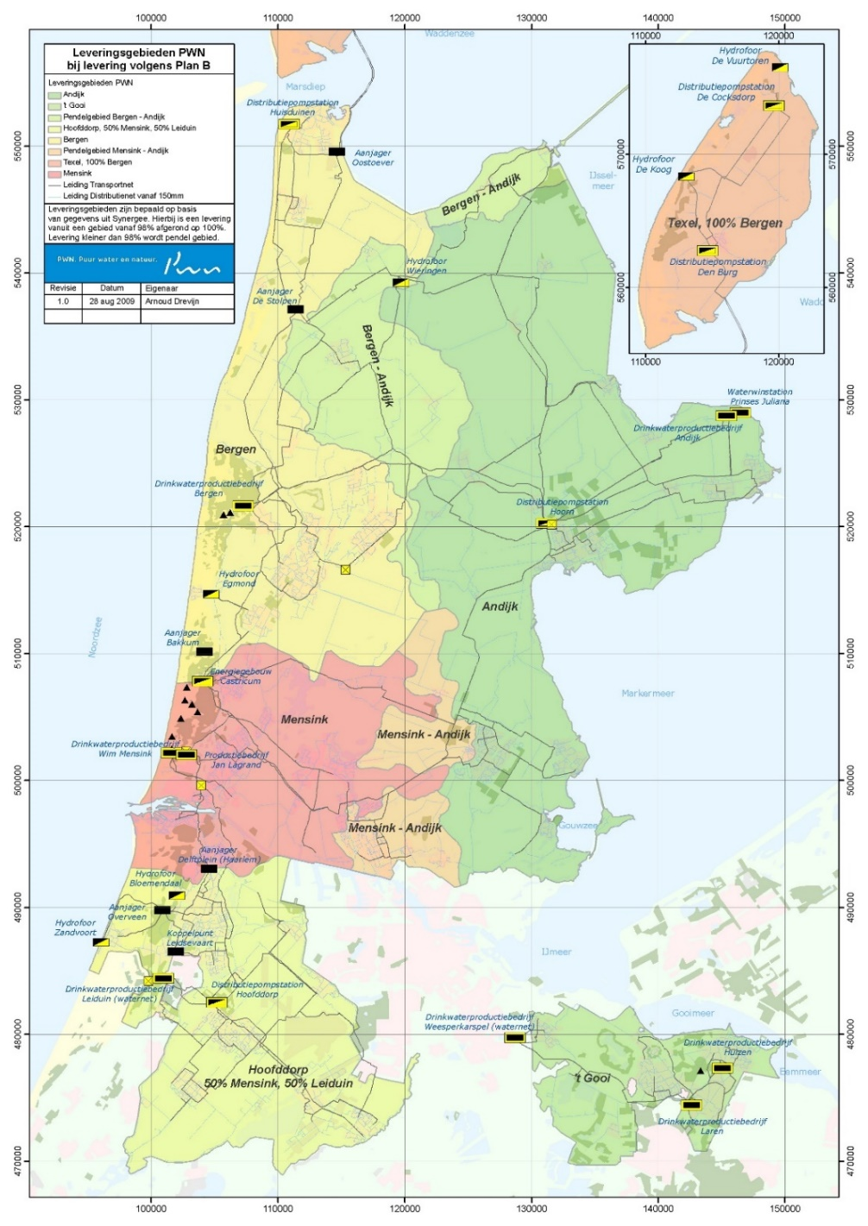
Production locations
WTP – Laren (ground water)
WTP – Martien den Blanken (direct surface water treatment)
WTP – Princess Juliana
WTP – Jan Lagrand
Dune infiltration area
WTP – Wim Mensink
WTP – Bergen

Slide 3
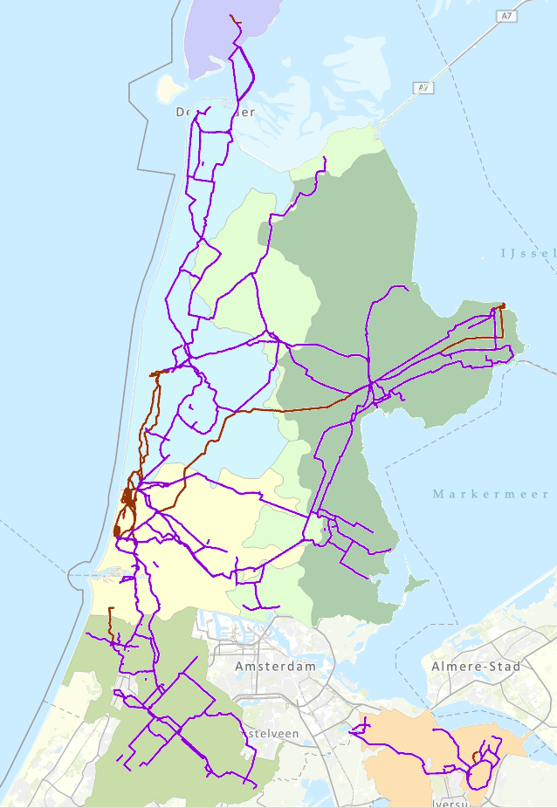
Distribution network
Connected distribution regions
Mixing zones

Slide 4

Transport and distribution pipes
Material | Pipe length (km) | Pipe length (%)
Asbestos cement | 3 960 | 38
PVC | 2 730 | 26
PE | 1 940 | 19
Grey cast iron | 590 | 6
Nodular cast iron | 520 | 5
Concrete | 350 | 3
Steel | 230 | 2
Else | 70 | 1
Total | 10 390 | 100

Slide 5
Hydraulics
Pressure:
Maximum 650 kPa at pumping station
Setpoint 300 kPa in network
To reach minimum of 200 kPa at 1.16 m3/h at customer
Residence time:
Minimal ½ day
Maximum 10 days
Usually 2-3 days

Slide 6
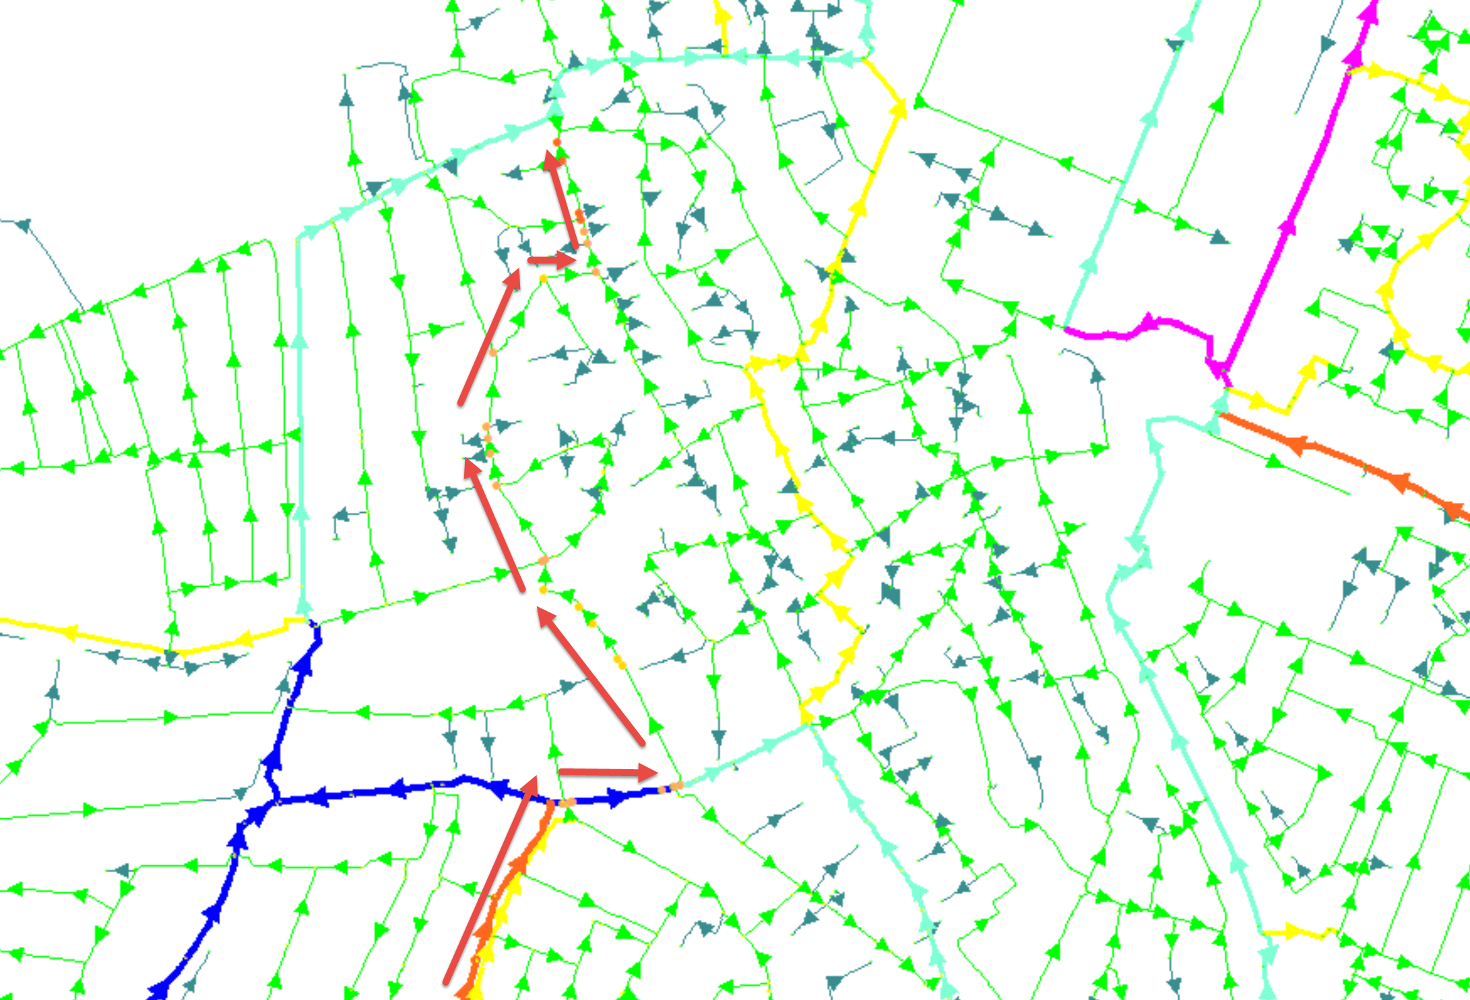
Hydraulic model
Synergi

Slide 7
Leakage
Non-revenue water ~6%
ILI = CARL / UARL
CARL = Current Actual Real Losses [liter/day]
UARL = Unavoidable Actual Real Losses [liter/day]
UARL = (18 x length DN+TN [km] + 0.8 x # lateral connections + 25 x length LCN [km]) x pressure [mwk]
ILI = 0.52

Slide 8
Monitoring water quality in distribution system
Hardly any online monitoring in distribution network
Tap samples ~4000 per year
Sampling by accreditated laboratory (Het Waterlaboratorium: HWL)
Hardly any exceedings of health-related parameters

Slide 9
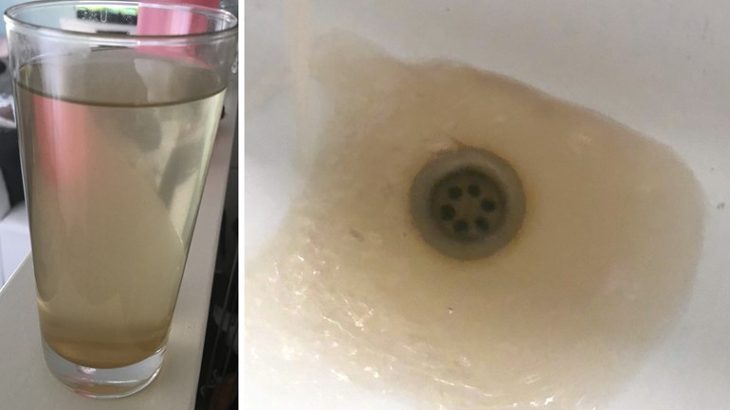
Brown water issues
Biological unstable water
Cast iron

Slide 10
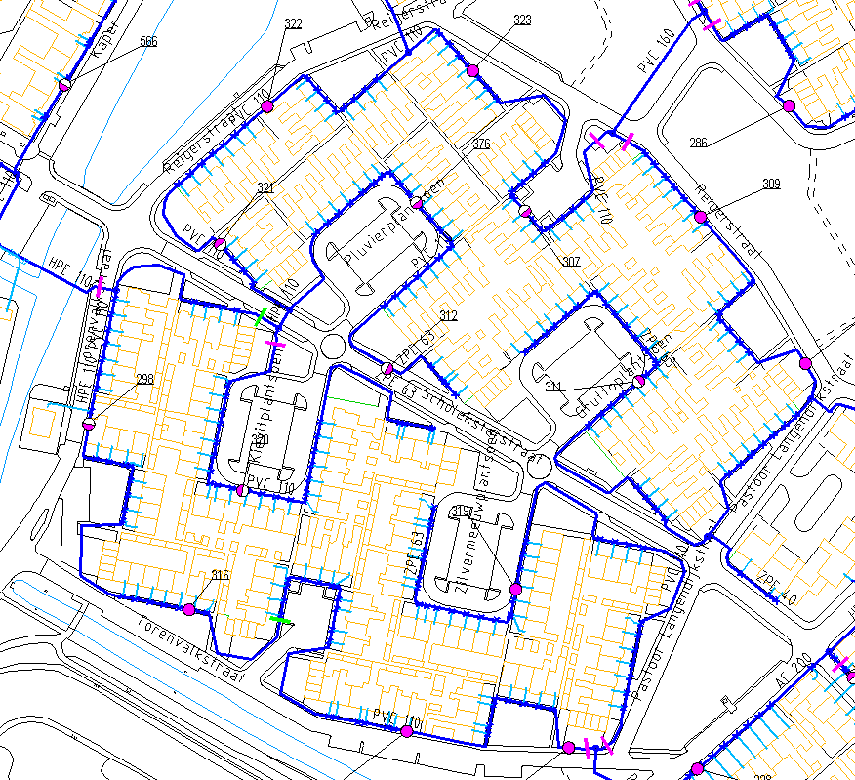
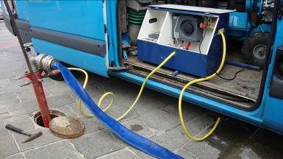
Flushing

Slide 11
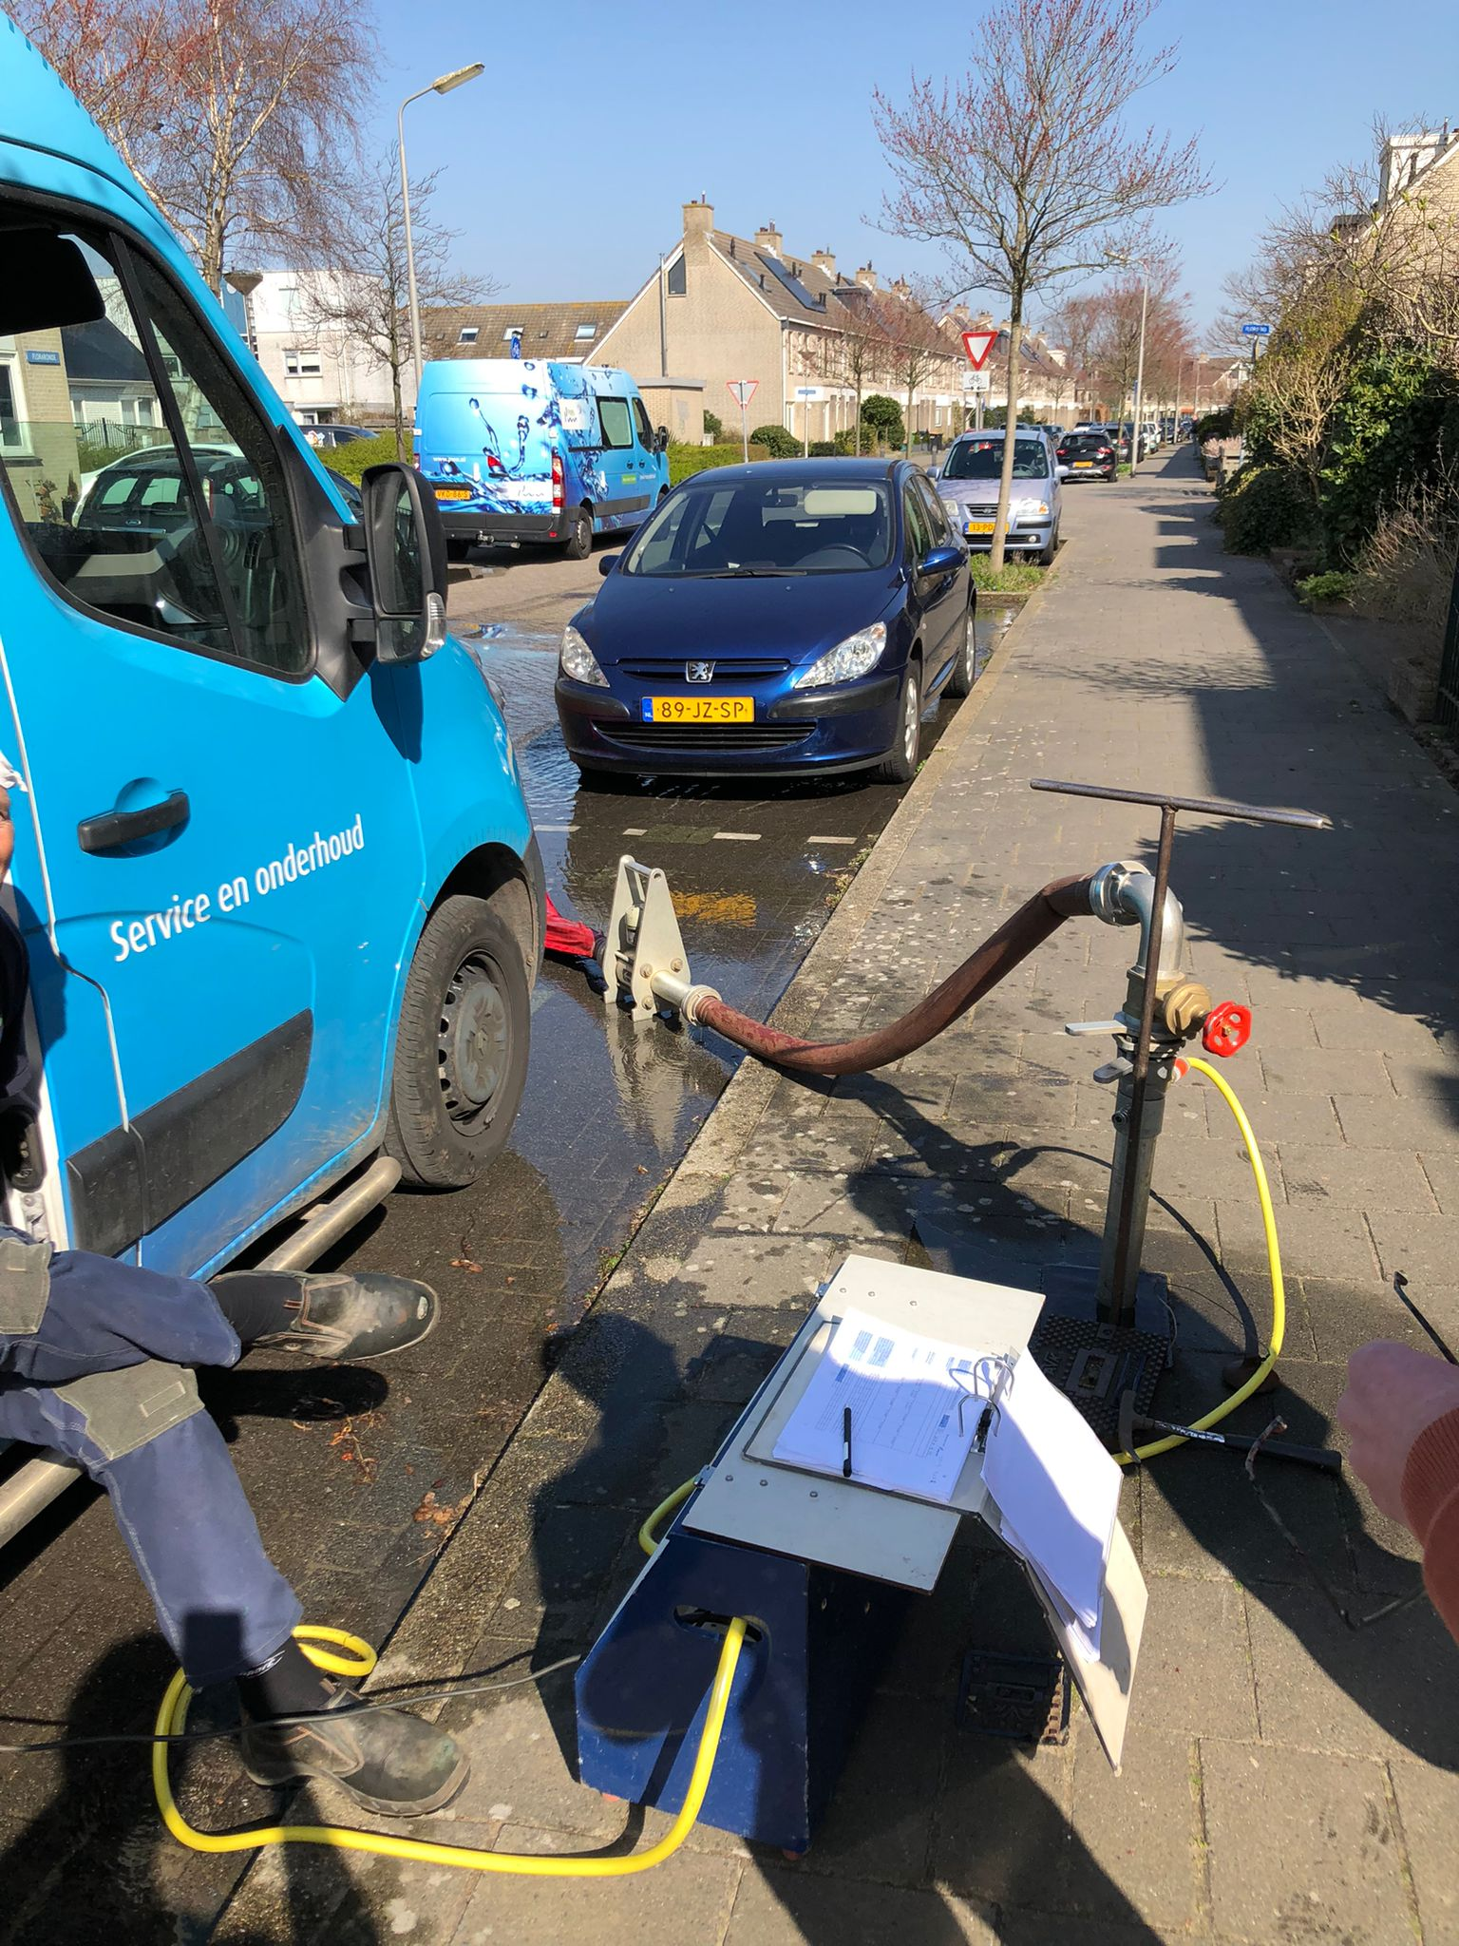
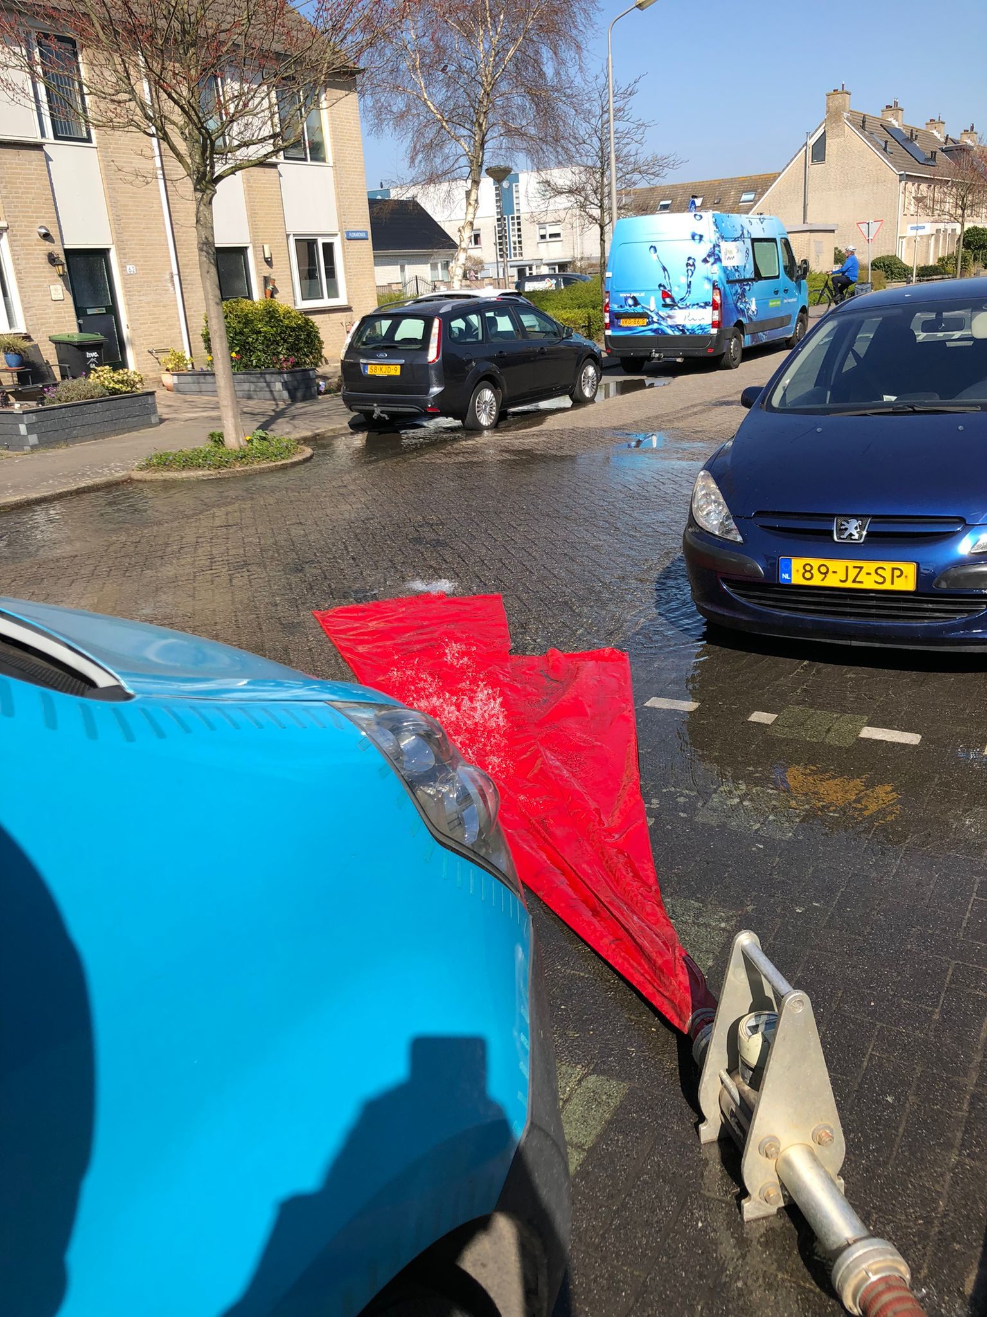
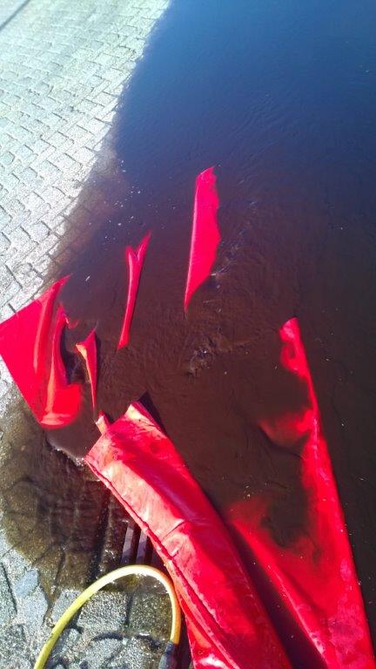
Flushing

Slide 12
So…
The extensive distribution system of PWN…
Has very limited water losses and provides drinking water of good quality…
Although the hydraulics are only partly known…
And has some challenges in coping with brown water at some locations.

